Slide 1

Turismo en la Web: Como Llegar a un Publico Global
Primer Congreso Internacional Punta del Este
David Hyman
Gerente, Online Sales
Google América Latina

Slide 2
Agenda
1 | Why Internet?
2 | Why Google?
3 | AdWords in Action
4 | Now What?
5 | The Penguin Story
2
Notes:
2

Slide 3
Why Internet?
3
Notes:
3

Slide 4
Critical Mass Worldwide
1.6B - Users Worldwide
230M – Users in the US
132M – Users in Latam
4
Notes:
4

Slide 5
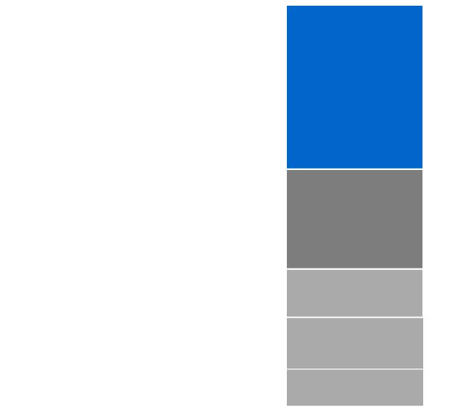
That´s Where Your Customers Are
Hotel Consumer Media Consumption
41% Online
25% TV
12% Print
13% Radio
9% Mobile
Source: Google Touchpoints Consumer Survey January 2009. TNS Jan – Nov 2008 Media Spend

Slide 6
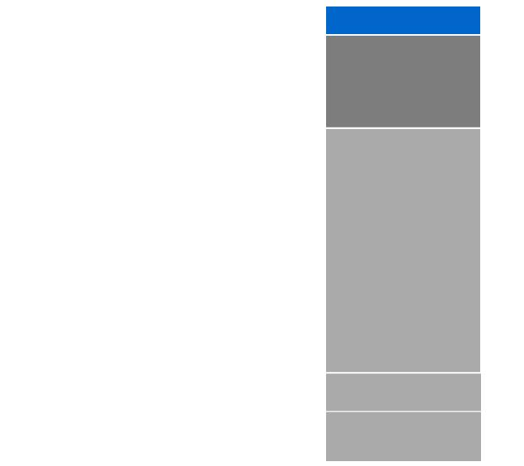
Missed Sales
Hotel Consumer Media Consumption
Hotel Industry Ad Spend
Untapped Audience
6% Online
Gap between ad spend and media consumption
41% Online
19% TV
50% Print
25% TV
(25% Newspaper, 25% Magazine)
12% Print
13% Radio
8% Radio
9% Mobile
10% Outdoor
6
Source: Google Touchpoints Consumer Survey January 2009. TNS Jan – Nov 2008 Media Spend

Slide 7




Most Influential Source of Travel Research
84% used Internet to research hotel in last six months
62% say Internet is the most important source, No. 2 is friends & family
77% used Internet to research hotel in last six months
48% say Internet is the most important source, No. 2 is friends & family
91% used Internet to research hotel in last six months
51% of research time spent using Online resources
7
Notes:
7

Slide 8
Keys Benefits of Internet Marketing
8
Notes:
8

Slide 9
Why Google?
9
Notes:
9

Slide 10
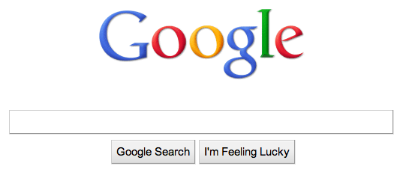
Why Search?
10
Notes:
10

Slide 11
Early & Often
68% used a search engine during the hotel booking process
Avg. of 8.5 searches
58% used a search engine during the hotel booking process
Avg. of 5.6 searches
80% used a search engine while researching travel
Avg. of 25.3 days researching, number of searches consistent with other regions.
11
Notes:
11

Slide 12
Travel Related Search Growing...
+70%
Growth in travel related searches about Uruguay, from Jan. 2008 to Jan. 2010, in Argentina and Brazil

Slide 13
Demand from Southern Cone Strong
+ 250.000
Monthly searches related to tourism (December 09) in Uruguay, from Argentina and Brazil

Slide 14
AdWords in Action
14
Notes:
14

Slide 15
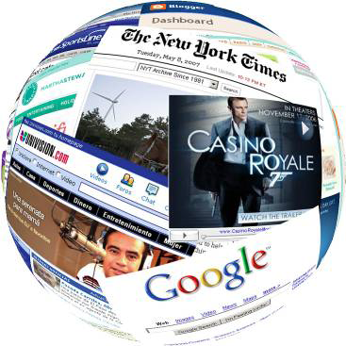
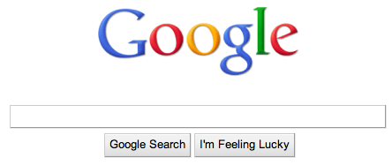
Two Parts…
Text Ads Relevant to the Users´Querey
Display, Video, or Text Ads
On Google´s Network of Partner Sites

Slide 16
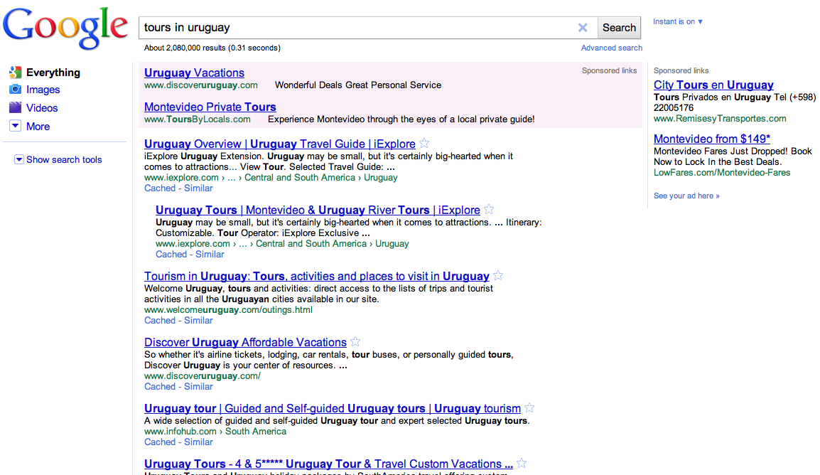
Search
Notes:
Let's think back to our previous example of marketing a low-calorie sweetner. In the online world, a consumer can search for low sugar recipes, find an ad related to the topic, and immediately go to the produt website to evaluate or purchase. Splenda's ad appears at the right time. The consumer goes from search -> awareness -> action within seconds.

Slide 17
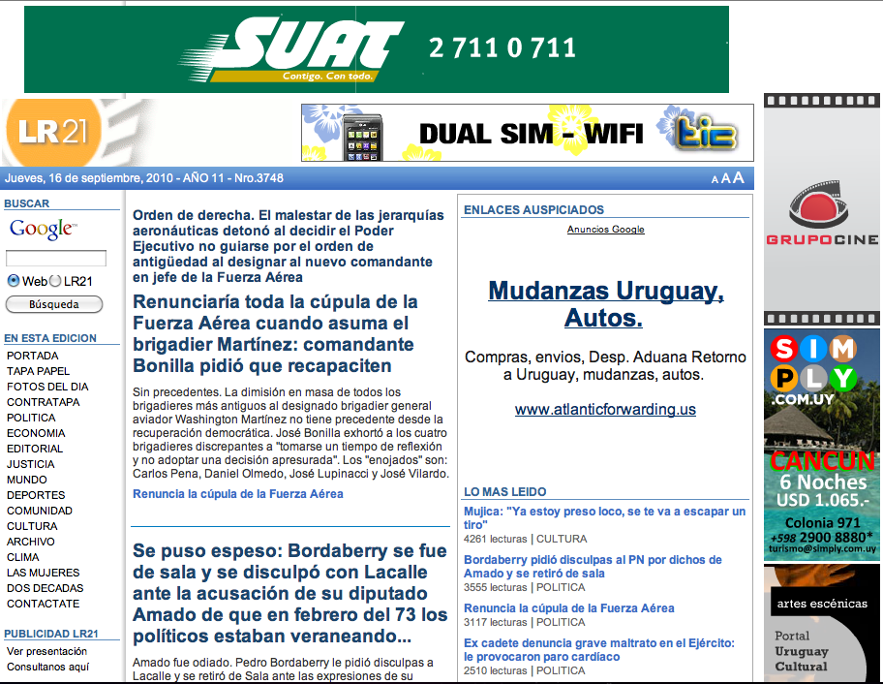

Google Display Network

Slide 18
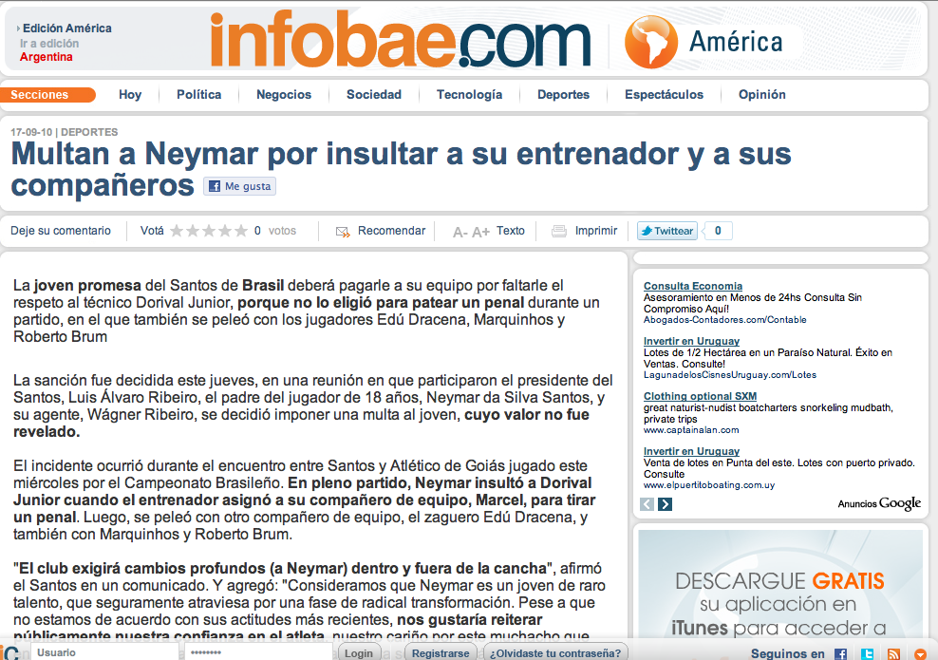
Google Display Network

Slide 19

















Your Custom Web
Large Sites
Niche Content
Your Custom Web
Source: AdRelevance Q1-Q4 2006 “Internet Ad Spend Is Display Only,” comScore Media Matrix, November 2005
Notes:
Wherever you market your business, it must be where your customers are.

Slide 20
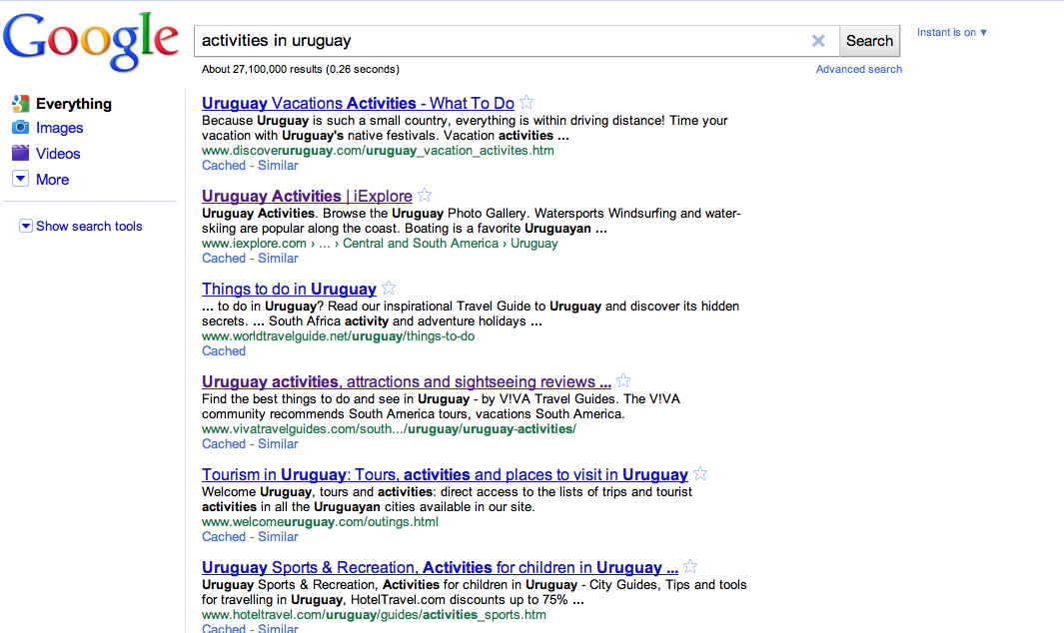
Let´s Check This Out…
Notes:
Let's think back to our previous example of marketing a low-calorie sweetner. In the online world, a consumer can search for low sugar recipes, find an ad related to the topic, and immediately go to the produt website to evaluate or purchase. Splenda's ad appears at the right time. The consumer goes from search -> awareness -> action within seconds.

Slide 21
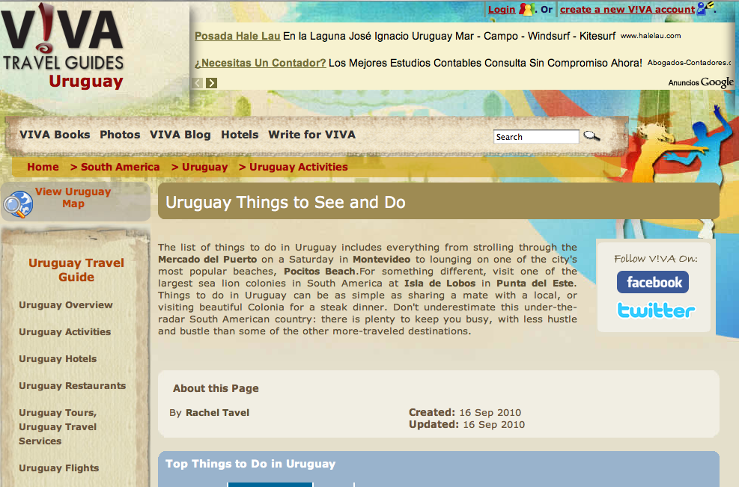

Viva Travel Guides...Great Information
Notes:
Let's think back to our previous example of marketing a low-calorie sweetner. In the online world, a consumer can search for low sugar recipes, find an ad related to the topic, and immediately go to the produt website to evaluate or purchase. Splenda's ad appears at the right time. The consumer goes from search -> awareness -> action within seconds.

Slide 22
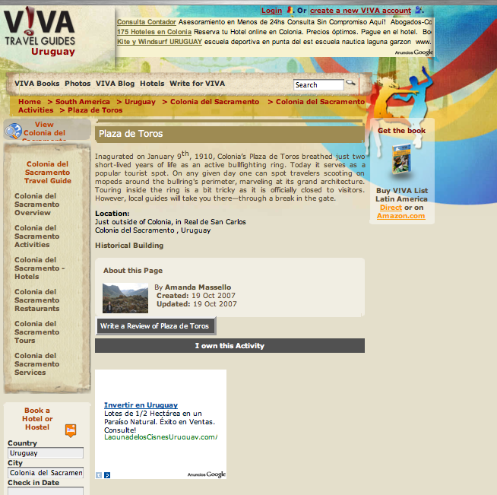

Plaza de Toros!
Notes:
Let's think back to our previous example of marketing a low-calorie sweetner. In the online world, a consumer can search for low sugar recipes, find an ad related to the topic, and immediately go to the produt website to evaluate or purchase. Splenda's ad appears at the right time. The consumer goes from search -> awareness -> action within seconds.

Slide 23
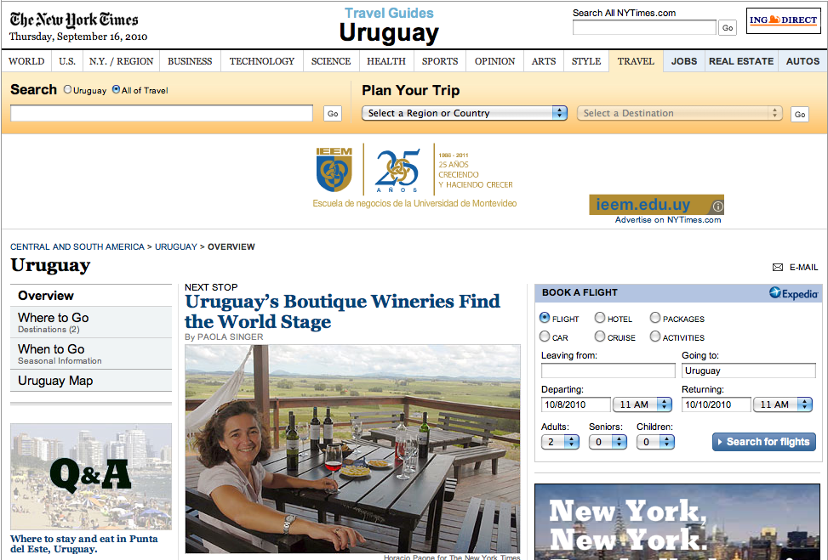
Let´s See What the ´Times Has to Say...
Notes:
Let's think back to our previous example of marketing a low-calorie sweetner. In the online world, a consumer can search for low sugar recipes, find an ad related to the topic, and immediately go to the produt website to evaluate or purchase. Splenda's ad appears at the right time. The consumer goes from search -> awareness -> action within seconds.

Slide 24
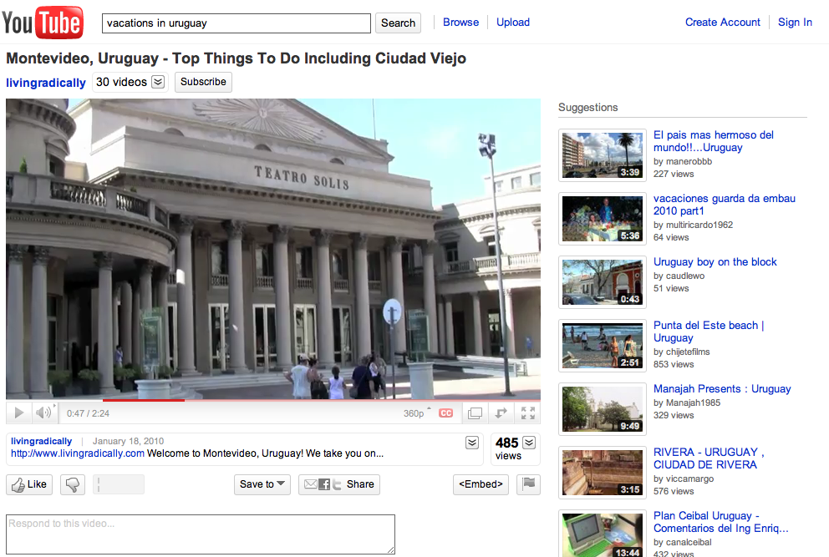
What a Neat Looking City
Notes:
Let's think back to our previous example of marketing a low-calorie sweetner. In the online world, a consumer can search for low sugar recipes, find an ad related to the topic, and immediately go to the produt website to evaluate or purchase. Splenda's ad appears at the right time. The consumer goes from search -> awareness -> action within seconds.

Slide 25
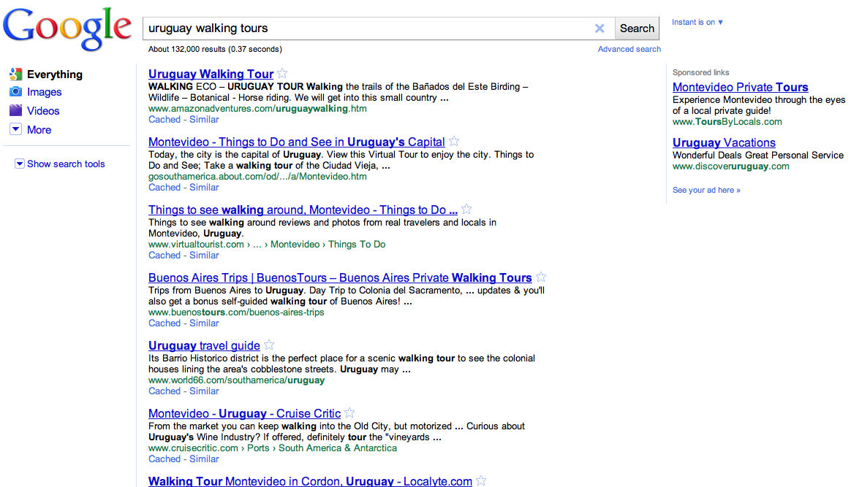

I Gotta Check Out These Walking Tours
Notes:
Let's think back to our previous example of marketing a low-calorie sweetner. In the online world, a consumer can search for low sugar recipes, find an ad related to the topic, and immediately go to the produt website to evaluate or purchase. Splenda's ad appears at the right time. The consumer goes from search -> awareness -> action within seconds.

Slide 26
Keys Benefits Internet Marketing
New Markets a Click Away
Manage Budgets According to Inventory
San Blas or Kobbe Beach?
Searches, Visits, Conversions, etc.
CPC
26
Notes:
26

Slide 27
Now What?
27
Notes:
27

Slide 28

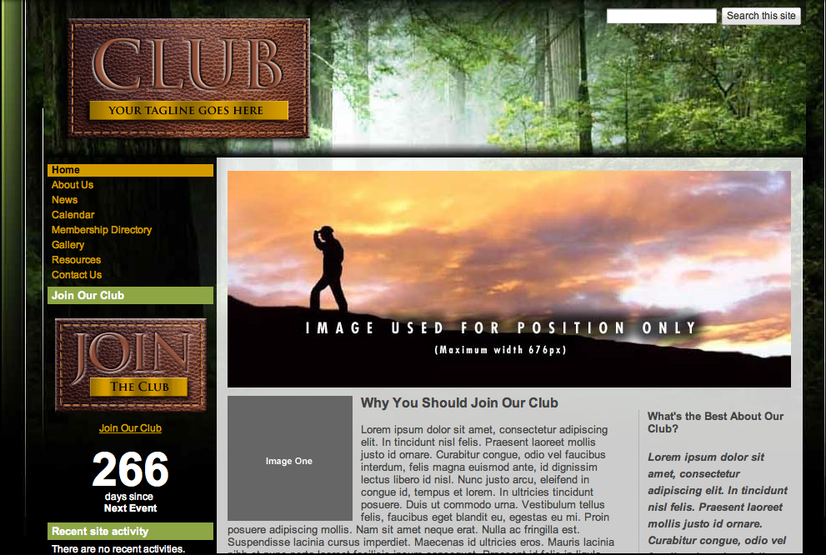
Create
28
Notes:
28

Slide 29
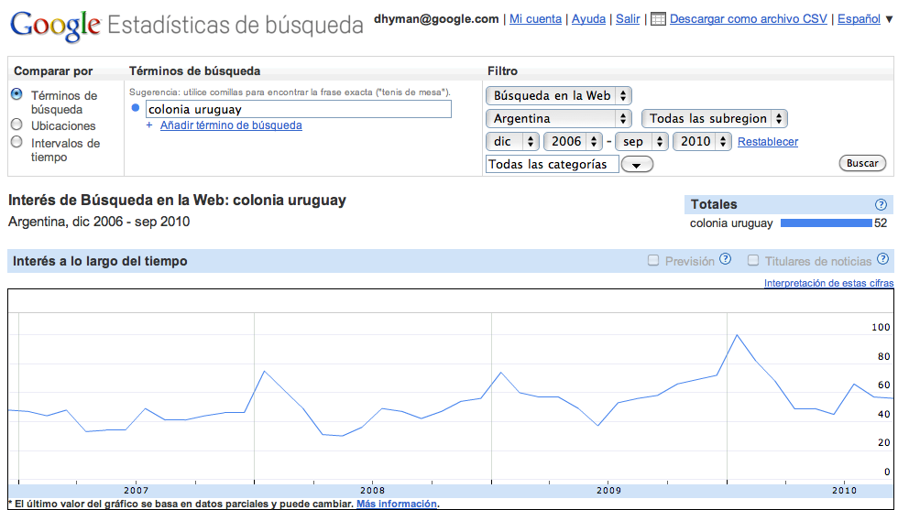
Plan
29
Notes:
29

Slide 30

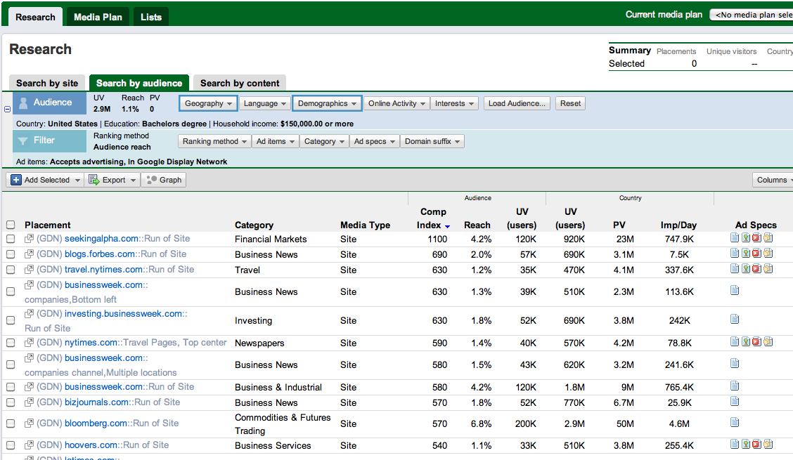
Plan
30
Notes:
30

Slide 31
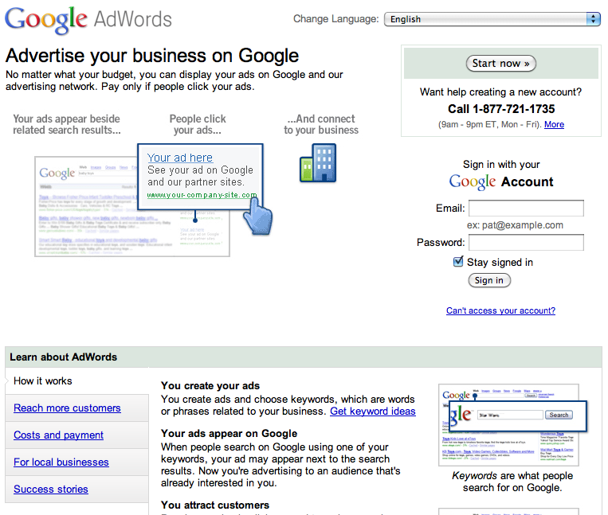
Implement
31
Notes:
31

Slide 32
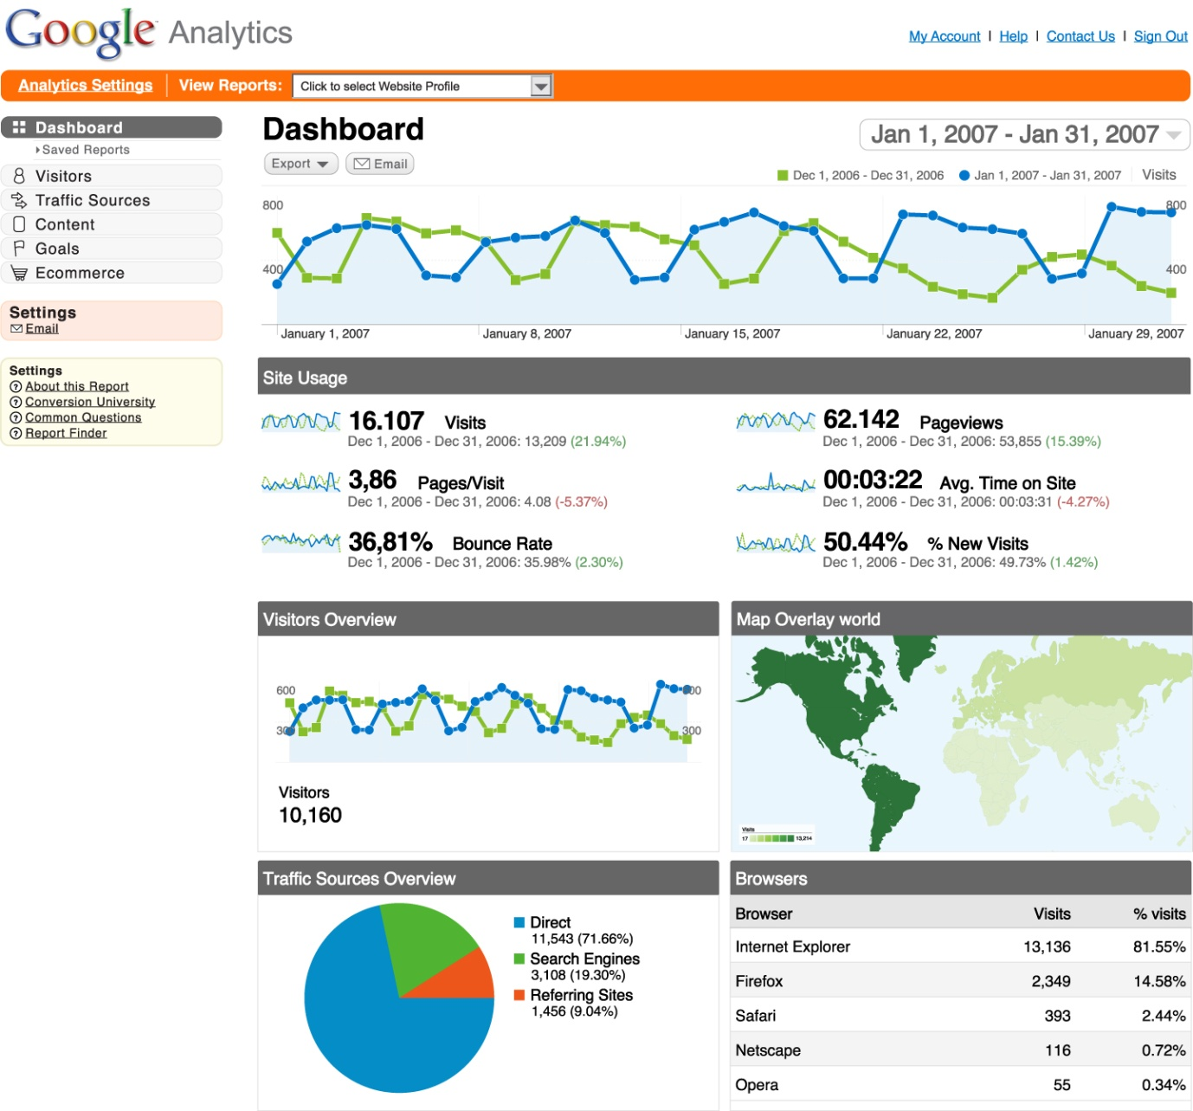
Measure
32
Notes:
32

Slide 33
Be Careful!!! 3 Tips to Success
Operators MUST be standing by.
Will your website help close the deal?
Don´t give up! Iterate, Measure, and Optimize.
33
Notes:
33

Slide 34
Ready for the Penguins?
34
Notes:
34

Slide 35
Q&A
David Hyman
dhyman@google.com
35
Notes:
35

